Slide 1
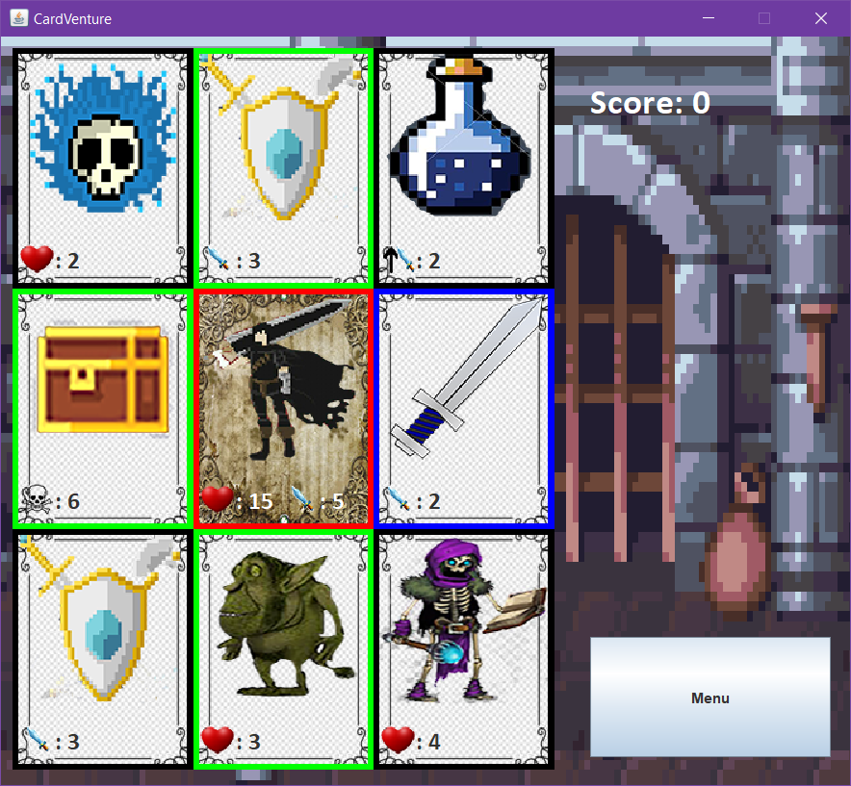
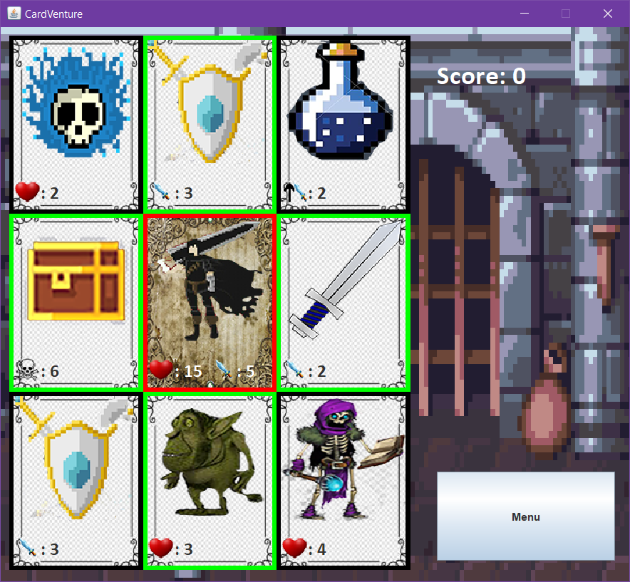
Welcome to CardVenture!
The aim of the game is very simple: get the highest Score you can achieve!

Slide 2

Every move you make counts as a point
You can move by clicking on a card or by using arrow keys
Your main character has red borders, your possible moves are green and your current choice is blue

Slide 3
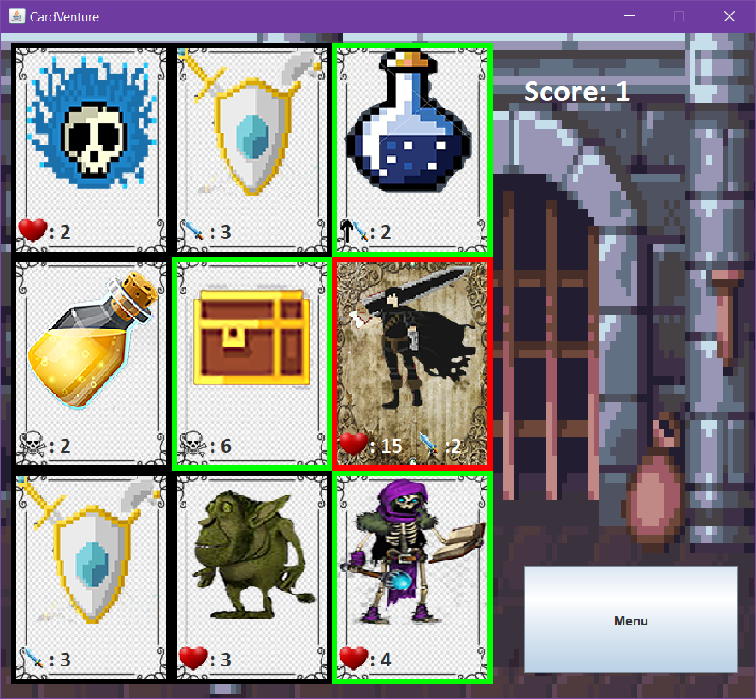
Your character has Life Points and Durability Points
Weapons have the sword icon: when you slide above one your durability becomes the one displayed
Traps have the skull icon: when you slide above one your life is decreased by the number displayed
Enemies have the heart icon: when you slide above one, one of two things can happen:
Your life is below or equal to the enemie’s and you don’t have durability. You die.
Your durability is above 0. The enemie’s life and your durability are decreased by the last one.

Slide 4
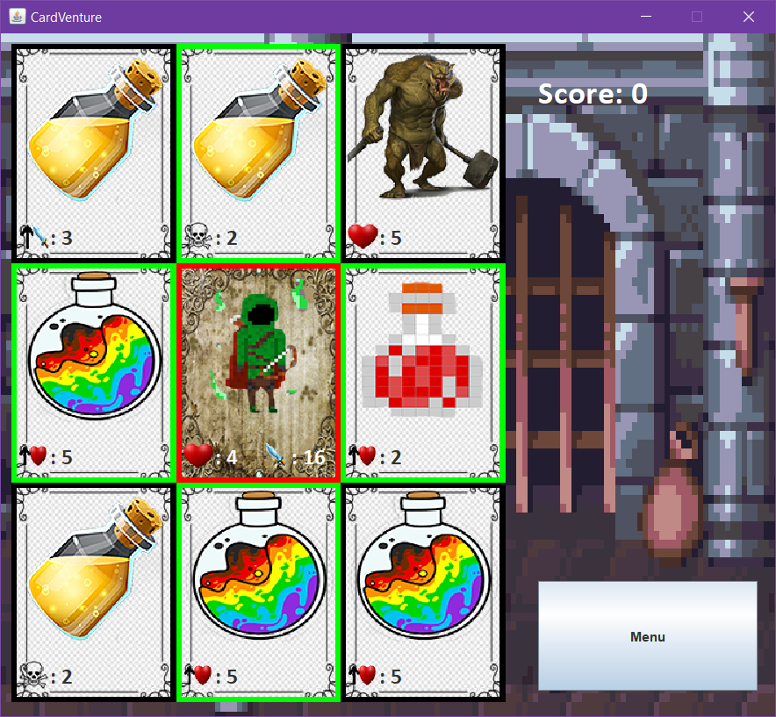
Lastly healing and durability potion are recognised by the upward black arrow.
The first one heals you by the displayed amount.
The second repairs your weapon. If you don’ have any your durability remains untouched!

Slide 5
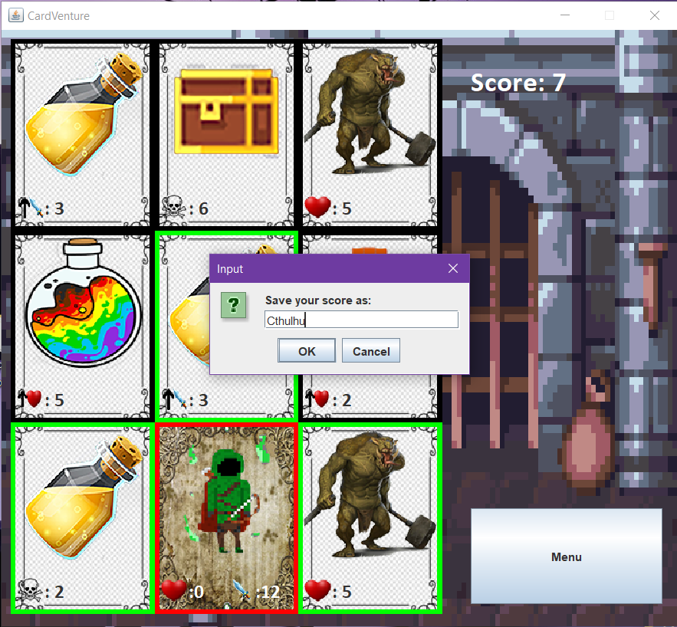
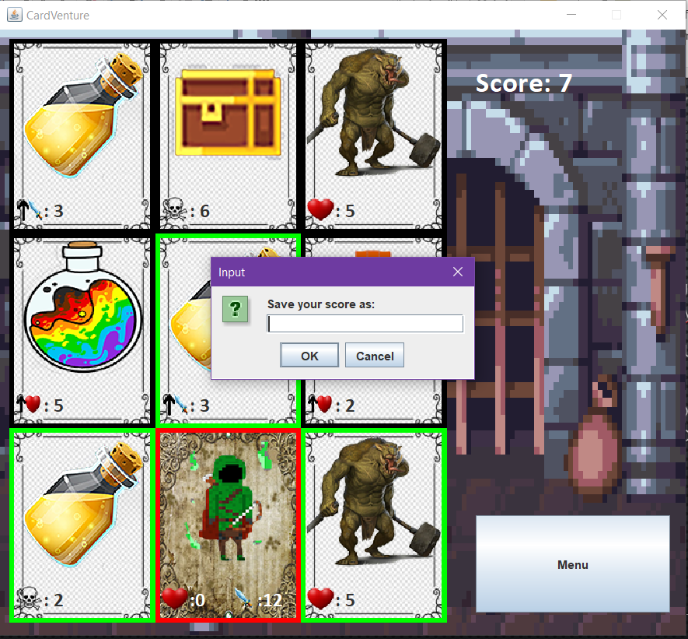
When your health reaches 0 it is Game Over!
But worry not! You can save your score and check the leaderboard anytime from the main menu
Now you are ready to begin. Good Luck!

